Slide 1

FACIAL EMOTION RECOGNIZER
UNIVERSITY WITH A PURPOSE
Department of Cybernetics,
School of Computer Science
University Of Petroleum And Energy Studies
Mentor :
Ms. Nitika Goenka
Presented By:
Kartik Tyagi Sahil Sangwan Shubham Patel R100218024 R100218050 R100216088

Slide 2
PROBLEM STATEMENT
To build a facial emotion recognizer that can detect a face from any source (i.e. image, video, or live feed) and then detect the expressions expressed by the feed.

Slide 3
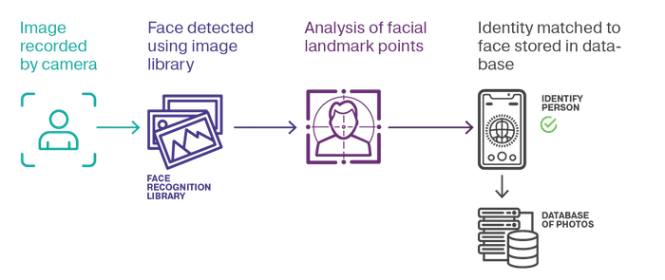
Face Recognition
Fig 1.1 Face recognition

Slide 4

What is OpenCV? And Why? (Open Source Computer Vision Library)
OpenCV is an open source computer vision and machine learning software library built to provide a common infrastructure for computer vision applications and to accelerate the use of machine perception in the commercial products.
Contains a library of programming functions mainly aimed real-time computer vision.
The library is cross-platform free for use under Open Source BSD license.
Major applications are object, face and gesture recognition, lip reading, Human- Computer Interaction(HCI), motion detection and much more.

Slide 5
Face detection using Haar Cascades
Robust and very quick.
15 times quicker than any technique at time of release.
Could be operated in real time.(95% accuracy at around 17fps)
Feature extraction and feature evaluation.
Classifier training and feature selection using a method called AdaBoost.

Slide 6
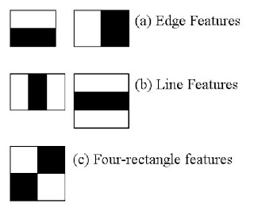
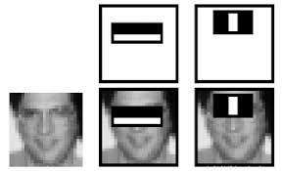
Feature’s and its extraction

Slide 7
CHALLENGES
Variations in pose
Illumination changes
Camera parameters
Occlusion

Slide 8
Advantages, and Disadvantages
High Detection Accuracy
Low false positive ratec
Computationally complex and slow
Longer training time.
Limitation in difficult lightening conditions.
Less robust to occlusion/obstacle

Slide 9
Feature Extraction
Feature extraction converts a pixel data of the face region into a higher-level representation of shape, color, texture, and spatial configuration of the face or its components. Feature extraction will reduce the dimension of the input space while keeping the important information. Feature extraction is important in formulating a better emotion categorization as the extracted facial feature given inputs to classification module which finally it categorizes different emotions. The technique used in this project is CNN

Slide 10
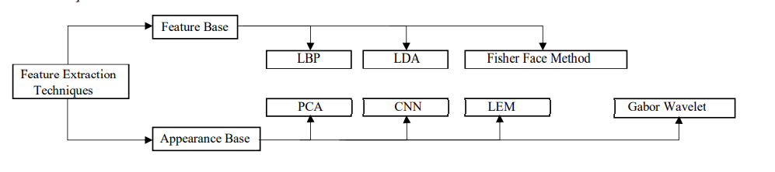
Flow Chart for Feature Extraction

Slide 11
Feature Classification
This stage is performed by a classifier. There are various classifications methods used to extract expressions. Two main types of classes used in facial expression recognition are action units and prototypic facial expressions.

Slide 12
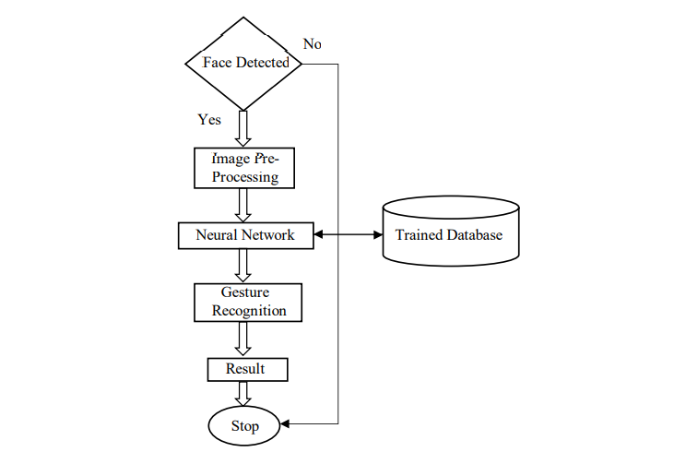
Flow Chart for Facial Classification

Slide 13
OBJECTIVE
Our main objective is to develop a system that can recognize emotions expressed by a human being. In our project the source could be an image or pre-recorded video or a live video feed. The objective can be divided in two parts as follows:
Our first objective would be to develop a system that can detect a face from any kind of source.
The second and main objective is to analyze the detected face and classify the kind of expression being expresses in that face.

Slide 14
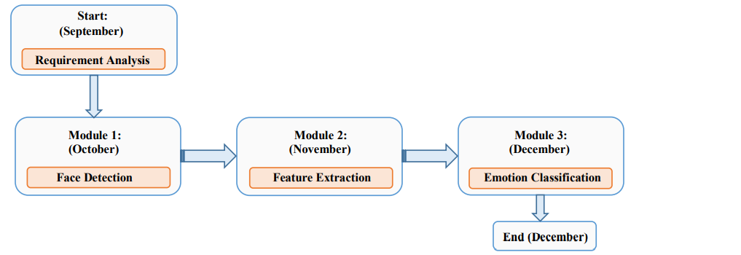
PERT CHART

Slide 15
Requirements
Windows OS (8 or higher)
Python version 3.0 or higher
Mobile phone with IP Webcam installed (optional)

Slide 16
REFERENCES
[1] B. Ko, “A Brief Review of Facial Emotion Recognition Based on Visual Information,” Sensors, vol. 18, no. 2, p. 401, 2018.
[2] R. C. Chivers, V. V Ramalingam, and A. Pandian, “Facial Emotion Recognition System – A Machine Learning Approach Facial Emotion
Recognition System ± A Machine Learning,” 2018.
[3] Ekman, P. (2013). Emotion in the Human Face. USA: Malor Books.
[4] P. Hespanha, D. J. Kriegman, and P. N. Belhumeur, “Eigenfaces vs . Fisherfaces : Recognition Using Class Specific Linear
Projection,” vol. 19, no. 7, pp. 711–720, 1997.
[5] M. H. Siddiqi, M. Alruwaili, J. Bang, and S. Lee, “Real Time Human Facial Expression Recognition System using Smartphone,”
vol. 17, no. 10, pp. 223–230, 2017
[6] M. H. Siddiqi et al., “A Brief Review of Facial Emotion Recognition Based on Visual Information,” 2018 IEEMA Eng. Infin. Conf. eTechNxT 2018, vol. 5, no. 1, pp. 196–201, 2018.
[7] P. Viola and M. Jones. Rapid object detection using a boosted cascade of simple features. In Proceed-
[8] Rainer Lienhart and Jochen Maydt. An extended set of haar-like features for rapid object detection.In Image Processing. 2002. Proceedings.
2002 International Conference on, volume 1, pages I–I. IEEE, 2002.
[9] John P Lewis. Fast template matching. In Vision interface, volume 95, pages 15–19, 1995.
[10] Meng Xiao He and Helen Yang. Microarray dimension reduction, 2009

Slide 17
Thank You!!!

